Slide 1


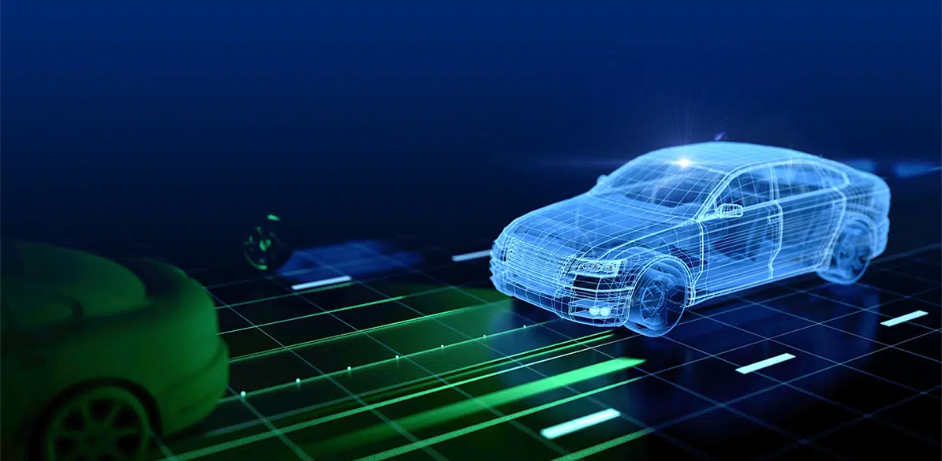
B.Tech Project on:
Road Obstacles Detection using Deep Learning-based Systems in ADAS System
Presented by
Guided by
Shrunmay Shivaji Shinde
(112115148) – 4th Semester
Dr. Meenakshi Choudhary
Course
Bachelors of Technology
Branch
Computer Science Engineering
Indian Institute of Information Technology Pune
26-04-2023

Slide 2
Content
Introduction
Literature review
Proposed Methodology
Dataset Information
Implementation Details
Experimental Outcomes
Applications
Conclusion
Future scope
References
Indian Institute of Information Technology Pune
26-04-2023
2

Slide 3
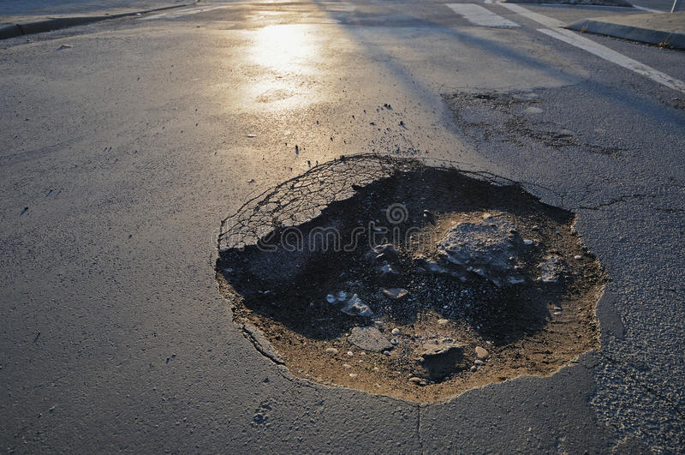
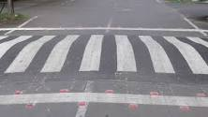

Introduction
Road safety is a major concern worldwide, and road obstacles are one of the leading causes of accidents.
Road obstacle detection using deep learning-based algorithms is an emerging area of research that aims to improve road safety and reduce accidents caused by obstacles on the road. This technology uses computer vision and deep learning techniques to detect obstacles such as potholes, speed breakers, debris, and other road hazards.
Advanced Driver Assistance System (ADAS) is a set of technologies that assist drivers in the driving process and helps them to avoid accidents by providing alerts or taking control of the vehicle.
Our Proposed System focuses on detection of road obstacles accurately using Convolutional Neural Network Deep Learning Algorithms and make driver and electronic control unit aware to prevent the damage and risk of accident.
Our System have been trained on various CNN models using transfer learning on the dataset consisting of labelled images of Normal Road, Potholes, Speedbumps and derive the accuracy for each model and use it for enhancement of functionality of Advanced Driver Assistance Systems (ADAS).
a.)
b.)
c.)
Figure 1: a) Pothole, b) Speedbumps, c.) Normal Condition
Source: Google Images
Indian Institute of Information Technology, Pune
26-04-2023
3

Slide 4
Literature review
Author | Title | Publishers/Source | Findings/ Remarks
Zihao Nie and Jian Qu [1] | Multi-task Autonomous Driving Based on Improved Convolutional Neural Network and ST Loss in MTS and MOD Modes | Current Applied Science and Technology Vol. 23 No. 3 (2022) | Implemented ResNet by adding some more convolutional layers and the new loss function is implemented. Accuracy obtained was 91%.
Nhat-Duc Hoang [2] | An Artificial Intelligence Method for Asphalt Pavement Pothole Detection Using Least Squares Support Vector Machine and Neural Network with Steerable Filter-Based Feature Extraction | Hindawi, Advances in Civil Engineering Volume 2018, Article ID 7419058 (2018) | Used Gaussian Filter for preprocessing for removing noise. Steerable Filter was used for image enhancement . ANN and LS-SVM were two AI approaches used. ANN accuracy was 85% and LS-SVM was 89%.
Seung-Ki Ryu,1 Taehyeong Kim,1 and Young-Ro Kim2 [3] | Image-Based Pothole Detection System for ITS Service and Road Management System | Hindawi Publishing Corporation, Mathematical Problems in Engineering Volume 2015, Article ID 968361 (2016) | Firstly, the images should be converted to binary images and then Morphology filter is used for detecting the dark regions and then the decision was made. Accuracy was 73.5%.
Indian Institute of Information Technology, Pune
26-04-2023
4

Slide 5
Literature review
Author | Title | Publishers/Source | Findings/ Remarks
Ding, S. and Qu, J. [6] | Smart car with road tracking and obstacle avoidance based on Resnet18-CBAM. | 7th International Conference on Business and Industrial Research (ICBIR), Bangkok, Thailand. (2022) | Usage of Resnet18-CBAM in smart cars for obstacle detection and avoidance.The hyperparameters have been filtered . The accuracy obtained is 72%.
Pandey, A.K., Iqbal, R., Maniak, T., Karyotis, C., Akuma, S. and Palade, V., [11] | Convolution neural networks for pothole detection of critical road infrastructure. | Computers and Electrical Engineering, page no.99. (2022) | 1D Convolutional Neural Network was used and accelerometer data was used for training. Test accuracy obtained is 83%.
A. Tithi, F. Ali and S. Azrof [12] | Speed Bump & Pothole Detection with Single Shot MultiBox Detector Algorithm & Speed Control for Autonomous Vehicle. | 2021 International Conference on Automation, Control and Mechatronics for Industry 4.0 (ACMI), Rajshahi, Bangladesh. (2021) | SSD (Single Shot Multibox Detector) algorithm was used. Rasberry Pi is used as processing unit. The signals are send to speed controller unit of car to reduce speed on detection of pothole or speedbump.
Indian Institute of Information Technology, Pune
26-04-2023
5

Slide 6
Research Gap
Flaws:
Model used in [1] is computationally more expensive. Accuracy – 91%.
Model used in [2] uses Gaussian filter which is time consuming and also the data is lost while removing noise. Accuracy- 89%.
Model used in [3] converts image into binary form and morphology filter also makes the model complex. Accuracy- 73.5%.
Model in [6] , even after filtering hyperparameters, the accuracy obtained is just 72%.
Model in [11] gives test accuracy as 83% only.
The SSD algorithm used in [12] is not capable of performing well on small objects.
Flaws recovered by our models:
As we are using transfer learning, time required to train is reduced.
The computational power required is less than the above proposed models.
By Transfer learning using fine tuning, better results are achieved over small dataset.
Indian Institute of Information Technology, Pune
26-04-2023
6

Slide 7

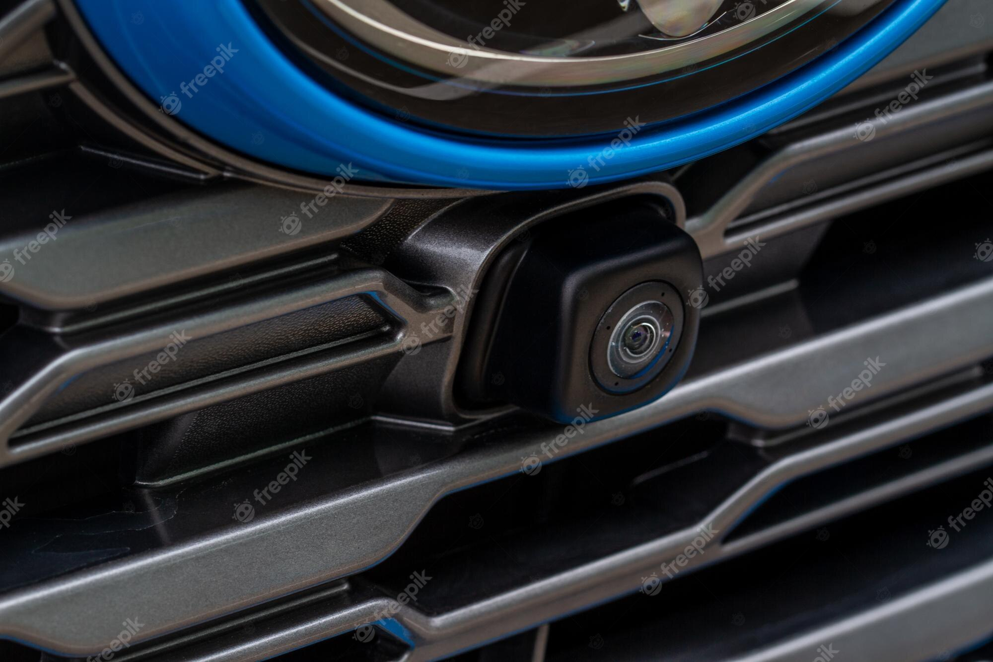
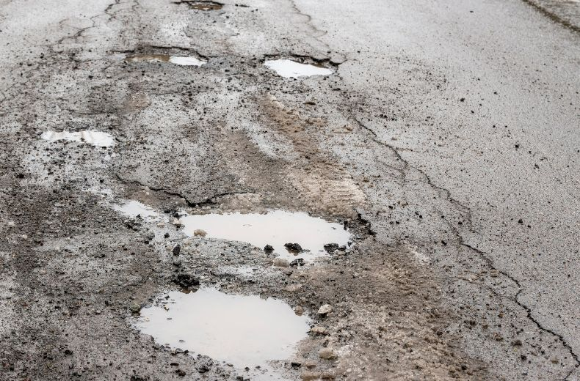
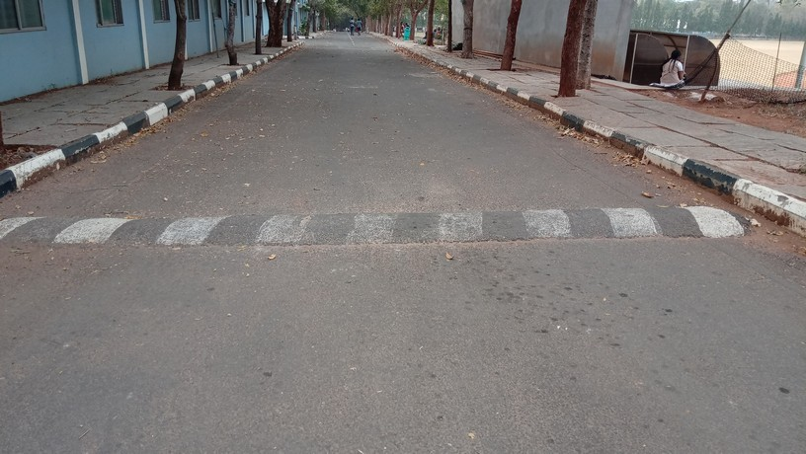
Proposed Methodology
Normal Condition
Feature Extraction Model
Classification Layer
Pothole
Image of Road taken by Mounted Camera
Convolutional Neural Network
Fully Connected Layer
Speedbumps
Source: Google Images
Indian Institute of Information Technology, Pune
26-04-2023
7

Slide 8
Proposed Methodology
Convolutional Neural Network (CNN) Models Implemented:
VGG16
ResNet50
Xception
InceptionV3
ExceptionNetB6
EfficinetNetV2B3
DenseNet169
Indian Institute of Information Technology, Pune
26-04-2023
8

Slide 9
Proposed Methodology
Steps Involved:
Data Preprocessing
Transfer Learning with Fine Tuning
Model Training and Testing
Performance Measures
Indian Institute of Information Technology, Pune
26-04-2023
9

Slide 10
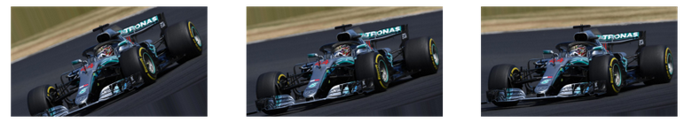
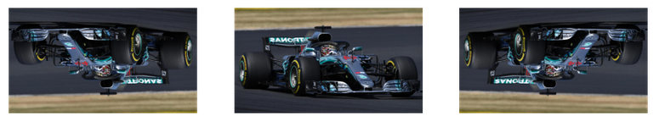
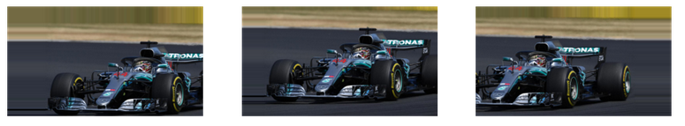
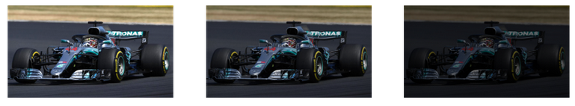
Proposed Methodology
i. Data Preprocessing:
Defining the Input Shape.
Image Augmentation.
a.)
b.)
c.)
d.)
Figure 2:
a.) Rotation Range , b.) Vertical Flip, c.) Width Shift Range, d.) Brightness Range
Source: www.analyticsvidhya.com
Indian Institute of Information Technology, Pune
26-04-2023
10

Slide 11
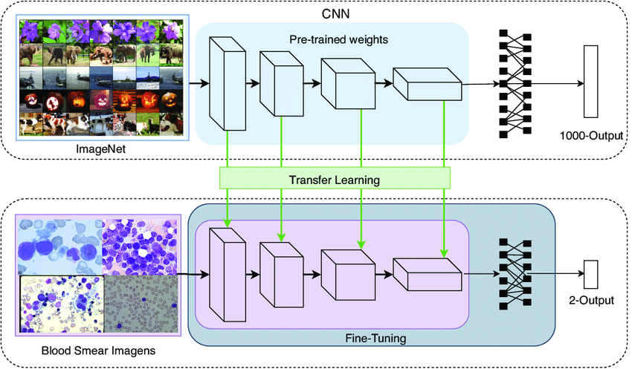
Proposed Methodology
ii. Transfer Learning using fine tuning
Loading the models from Keras official documentation: https://keras.io/api/applications/
Applying Fine Tuning and making some layers Trainable for our dataset.
Defining new Classification Layer based on our requirements.
Figure 3: Transfer Learning Using Fine Tuning
Source: www.researchgate.net
Indian Institute of Information Technology, Pune
26-04-2023
11

Slide 12
Proposed Methodology
iii. Model Training and Testing
Compilation of Model using Stochastic Gradient Descent(SGD) as optimizer, categorical_crossentropy as loss function and metrics as Accuracy.
Usage of Reduced Learning Rate as Callback.
Training and Testing the model using 70 epochs with 50 steps per epoch.
Indian Institute of Information Technology, Pune
26-04-2023
12

Slide 13
Proposed Methodology
iv. Performance Measure:
The performance measure(metrics) used is ‘Accuracy’.
Indian Institute of Information Technology, Pune
26-04-2023
13

Slide 14
Dataset
Data Preparation:
Dataset for images of potholes and normal roads collected from Kaggle:
https://www.kaggle.com/datasets/atulyakumar98/pothole-detection-dataset
https://www.kaggle.com/datasets/daviddjukic/pothole-detection
Dataset for images of Speedbumps collected from Mendeley Data:
https://data.mendeley.com/datasets/xt5bjdhy5g/1
This datasets are then merged to form the dataset we used.
ii. Dataset:
Our Dataset consists of Training and Testing Sets with each of them having three classes: Normal , Potholes and Speedbumps.
We have uploaded our dataset on Kaggle and it can be accessed from:
https://www.kaggle.com/datasets/shrunmayshinde/road-obstacles-detection
Our Dataset consists of two directories: Training Set and Testing Set. Each of this directory has 3 classes namely- Normal, Pothole, Speedbumps.
Training set consists of 1703 images belonging to 3 classes.
Testing set consists of 440 images belonging to 3 classes.
Indian Institute of Information Technology, Pune
26-04-2023
14

Slide 15
Implementation Details
Tools Used:
Python: There are several libraries in Python, including TensorFlow, Keras, PyTorch, Matplotlib that provide powerful tools for building and training CNNs.
2.Deep Learning Frameworks: There are several deep learning frameworks available that provide high-level APIs for building and training CNNs. TensorFlow and Keras are some of the deep learning frameworks used.
3.GPU: Training CNNs requires a lot of computational power, and using a Graphics Processing Unit (GPU) can significantly speed up the training process. We have used Google Colab ( a cloud computing service) which provides GPU support at backend.
4.Visualization Tools: Matplotlib is a popular Python library used for creating static, animated, and interactive visualizations. We have used it for making Accuracy and loss graphs.
5.Cloud Services: Cloud service Google Colab platform have provided the cloud computing capability for training and deploying the deep learning algorithms.
Indian Institute of Information Technology, Pune
26-04-2023
14

Slide 16
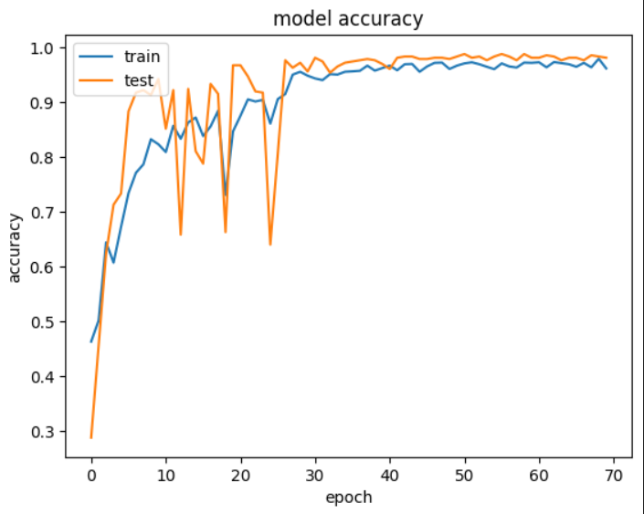
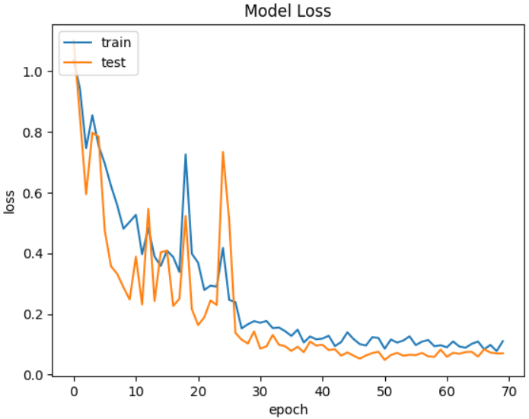
Experimental Outcomes
1. VGG16:
The Accuracy and Loss graphs for various models are:
Accuracy – 98.18% | Loss – 7.05%
Indian Institute of Information Technology, Pune
26-04-2023
16

Slide 17
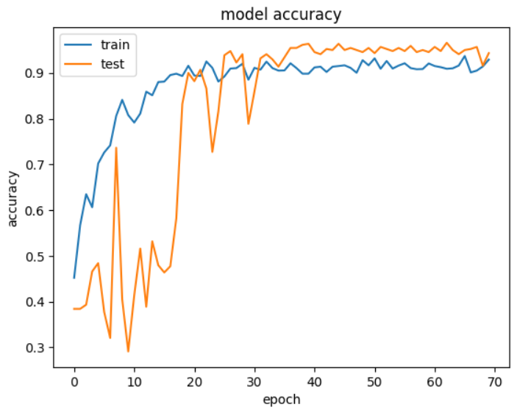
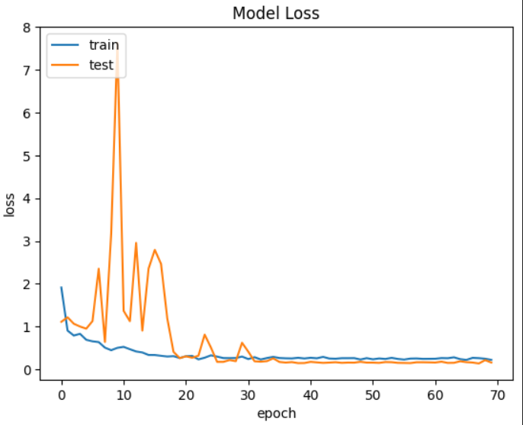
Experimental Outcomes
2. ResNet50:
Accuracy – 94.32% | Loss – 15.59%
Indian Institute of Information Technology, Pune
26-04-2023
17

Slide 18
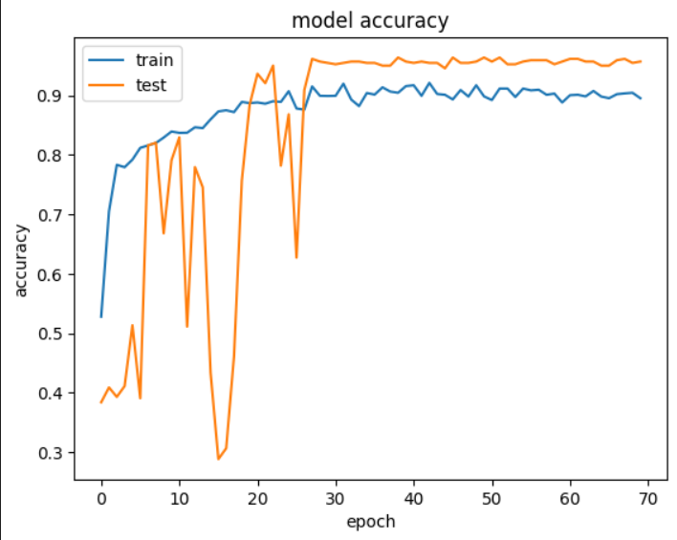
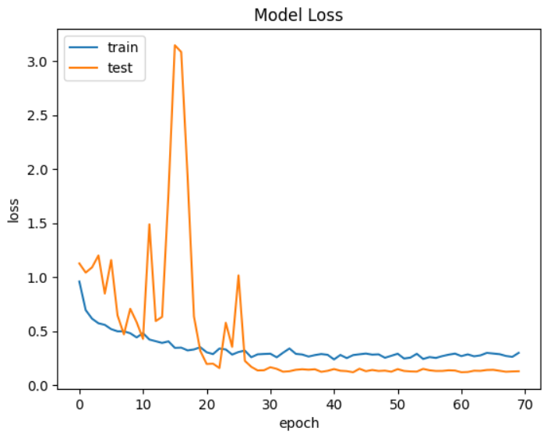
Experimental Outcomes
3. Xception:
Accuracy – 95.68% | Loss – 12.84%
Indian Institute of Information Technology, Pune
26-04-2023
18

Slide 19
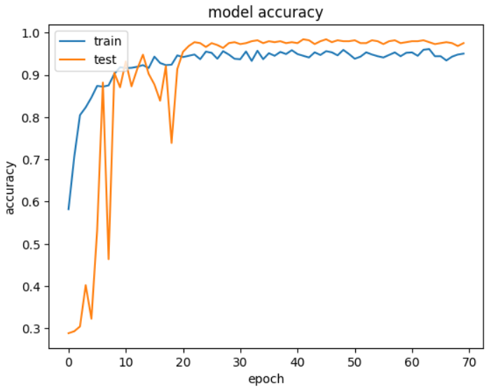
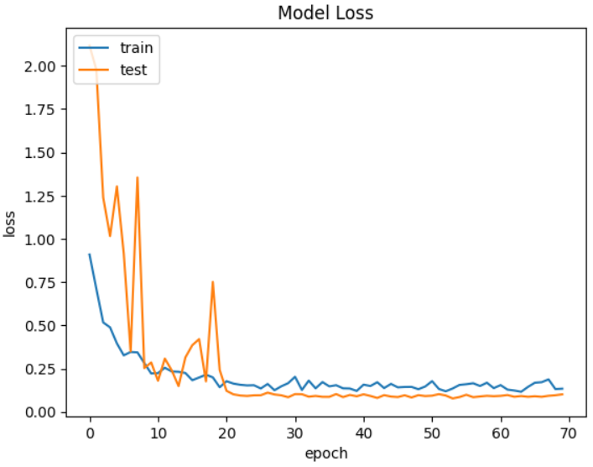
Experimental Outcomes
4. InceptionV3:
Accuracy-94.77% | Loss – 10.67%
Indian Institute of Information Technology, Pune
26-04-2023
19

Slide 20

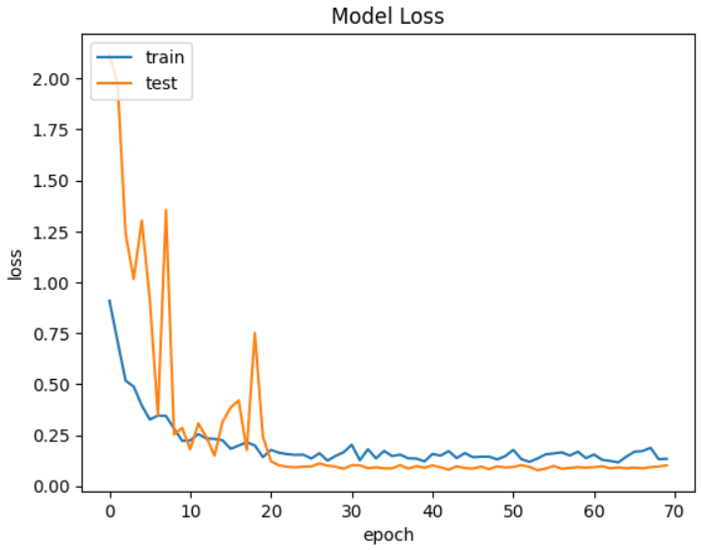
Experimental Outcomes
5. EfficientNetB6:
Accuracy- 97.50% | Loss – 10.17%
Indian Institute of Information Technology, Pune
26-04-2023
20

Slide 21
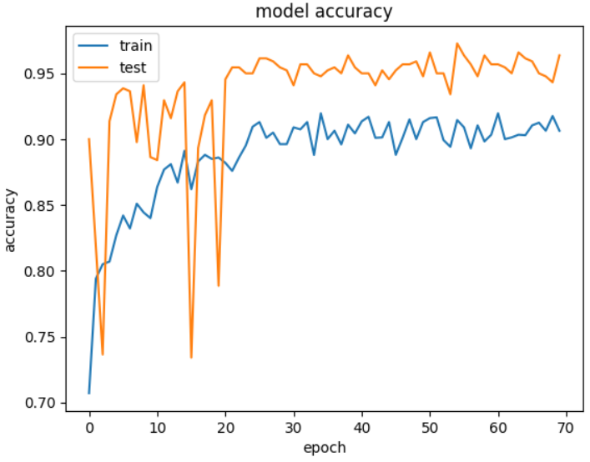
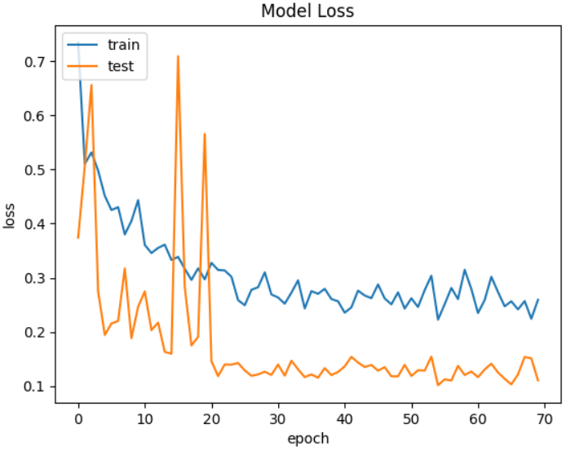
Experimental Outcomes
6. EfficientV2B3:
Accuracy – 96.36% | Loss – 11.05%
Indian Institute of Information Technology, Pune
26-04-2023
21

Slide 22
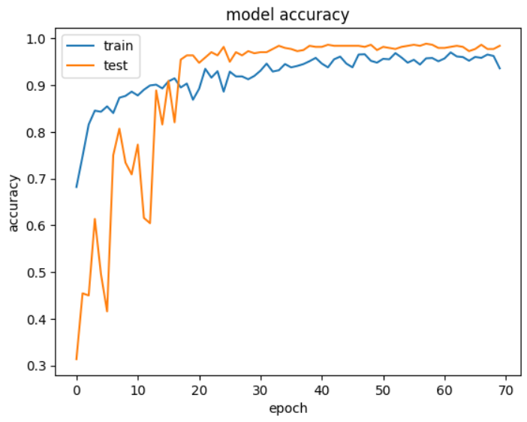
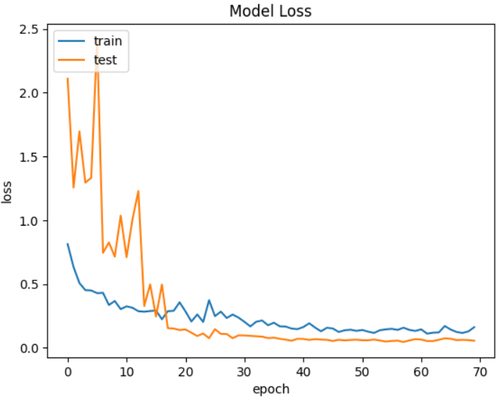
Experimental Outcomes
7. DenseNet169:
Accuracy – 97.73% | Loss – 5.52%
Indian Institute of Information Technology, Pune
26-04-2023
22

Slide 23
Experimental Outcomes
Comparison Table for models implemented:
Model | Accuracy
VGG16 | 98.18%
ResNet50 | 94.32%
Xception | 95.68%
InceptionV3 | 94.77%
EfficientNetB6 | 97.50%
EfficientNetV2B3 | 96.36%
DenseNet169 | 97.73%
Indian Institute of Information Technology, Pune
26-04-2023
23

Slide 24
Experimental Outcomes
Comparison with the existing models:
 | Existing Models | Proposed Models
 | MT- LS-SVM Segmentation-Resnet181D Conv. Resnet26- Candidate- -CBAM Neural MSE_TRT Detect Network | VGG16 ResNet50 Xception InceptionV3 EfficientNetB6 EfficientNetV2B3 DenseNet169
Accuracy | 93% 89% 73.5% 72% 83% | 98.18% 94.32% 95.68% 94.77% 97.50% 96.36% 97.73%
Indian Institute of Information Technology, Pune
26-04-2023
24

Slide 25
Applications
Currently, in India, the most luxurious vehicles comes with level 2 ADAS system. Road Obstacles detection falls under the level 4 of ADAS system.
Autonomous vehicle technology.
Assisting Driver in Low Visibility.
Indian Institute of Information Technology, Pune
26-04-2023
25

Slide 26
Conclusion
The road obstacles detection project is a critical step towards improving road safety and reducing accidents caused by damaged roads. By using computer vision techniques and deep learning algorithms, we have developed a system that can accurately detect potholes and speedbumps on the road surface in real-time.
While our project has achieved promising results, there is still room for improvement. We can further refine our algorithms to reduce false positives and false negatives, and integrate the system with existing road infrastructure to provide real-time alerts to drivers.
Indian Institute of Information Technology, Pune
26-04-2023
26

Slide 27
Future scope
The future scope of pothole detection technology in vehicles is promising, with advancements in sensor technology, machine learning, and vehicle-to-vehicle (V2V) communication enabling more efficient and effective detection of potholes. Here are a few potential areas of development:
Integration with vehicle systems.
2.V2V communication.
3.Machine learning algorithms.
4.Autonomous vehicle technology.
Overall, the future scope of pothole detection technology in vehicles is promising and could help to improve road safety, reduce vehicle damage, and enhance the performance of autonomous vehicles.
Indian Institute of Information Technology, Pune
26-04-2023
27

Slide 28
References
[1] Zihao Nie and Jian Qu, “Multi-task Autonomous Driving Based on Improved Convolutional Neural Network and ST Loss in MTS and MOD Modes”, Current Applied Science and Technology Vol. 23 No. 3, 28 October 2022.
[2] Nhat-Duc Hoang, “An Artificial Intelligence Method for Asphalt Pavement Pothole Detection Using Least Squares Support Vector Machine and Neural Network with Steerable Filter-Based Feature Extraction”, Hindawi Publication Corporation, Advances in Civil Engineering Volume 2018, Article ID 7419058, 6 June 2018.
[3] Seung-Ki Ryu, Taehyeong Kim and Young-Ro Kim, “Image-Based Pothole Detection System for ITS Service and Road Management System”, Hindawi Publishing Corporation, Mathematical Problems in Engineering Volume 2015, Article ID 968361, 22 April 2016.
[4] Bechtel, M.G., McEllhiney, E., Kim, M. and Yun, H., 2018. Deeppicar, “A low-cost deep neural network-based autonomous car.” Proceedings of the 2018 IEEE 24th International Conference on Embedded and Real-time Computing Systems and Applications (RTCSA), Hakodate, Japan, August 28-31, 2018
[5] Meyer, G.P. and Thakurdesai, N., 2020. “Learning an uncertainty-aware object detector for autonomous driving.” Proceedings of the 2020 IEEE/RSJ International Conference on Intelligent Robots and Systems (IROS), Las Vegas, NV, USA, October 24, 2020 - January, 24, 2021, pp. 10521-10527.
Indian Institute of Information Technology, Pune
26-04-2023
28

Slide 29
References
[6] Ding, S. and Qu, J., 2022. “Smart car with road tracking and obstacle avoidance based on Resnet18-CBAM.” Proceedings of the 2022 7th International Conference on Business and Industrial Research (ICBIR), Bangkok, Thailand, May 19-20, 2022.
[7] Yılmaz, E. and Tarıyan Özyer, S., 2019. “Remote and autonomous controlled robotic car based on Arduino with real time obstacle detection and avoidance.” Universal Journal of Engineering Science, 7(1), DOI: 10.13189/ujes.2019.070101.
[8] Banerjee, A., Bolar, V., Chaurasia, A., Maurya, S. and Gite, Y., 2020. “Autonomous driving vehicle.” International Research Journal of Engineering and Technology (IRJET), 7(4), 6048- 6050.
[9] R. A. Nair, D. K. Suresh and R. D, "Predicting the Impact of Road Conditions on Battery Health Via Transfer Learning," 2023 Third International Conference on Artificial Intelligence and Smart Energy (ICAIS), Coimbatore, India, 2023, pp. 1194-1200, doi: 10.1109/ICAIS56108.2023.10073732.
[10] Thu, May, Nikom Suvonvorn, and Nichnan Kittiphattanabawon. "Pedestrian classification on transfer learning based deep convolutional neural network for partial occlusion handling." International Journal of Electrical and Computer Engineering (IJECE) 13.3 (2023): 2812-2826.
Indian Institute of Information Technology, Pune
26-04-2023
29

Slide 30
References
[11] Pandey, A.K., Iqbal, R., Maniak, T., Karyotis, C., Akuma, S. and Palade, V., 2022. “Convolution neural networks for pothole detection of critical road infrastructure.” Computers and Electrical Engineering, 99, p.107725.
[12] A. Tithi, F. Ali and S. Azrof, "Speed Bump & Pothole Detection with Single Shot MultiBox Detector Algorithm & Speed Control for Autonomous Vehicle," 2021 International Conference on Automation, Control and Mechatronics for Industry 4.0 (ACMI), Rajshahi, Bangladesh, 2021, pp. 1-5.
Indian Institute of Information Technology, Pune
26-04-2023
30

Slide 31


